Slide 1

HACK THE MOUNTAIN
GREEN QUEEN
Team members:-
Anshi Srivastav
Avishka Karn
Jiya Garg
Kirti Morya

Slide 2
NEER SANCHAY
How much water of reverse osmosis system is useable ?

Slide 3

Problem statement
Can I use RO waste water
In Reverse Osmosis (R.O system) each 1L of water that is cleaned discharges about 3L of effluent.
This grey water has high amount of TDS so can be used practically anywhere other than for drinking .

Slide 4
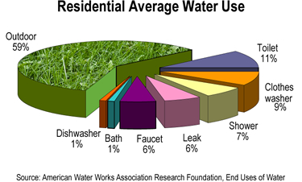
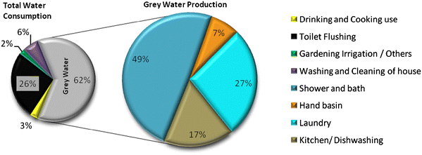
Stats – usage of water in daily basis

Slide 5
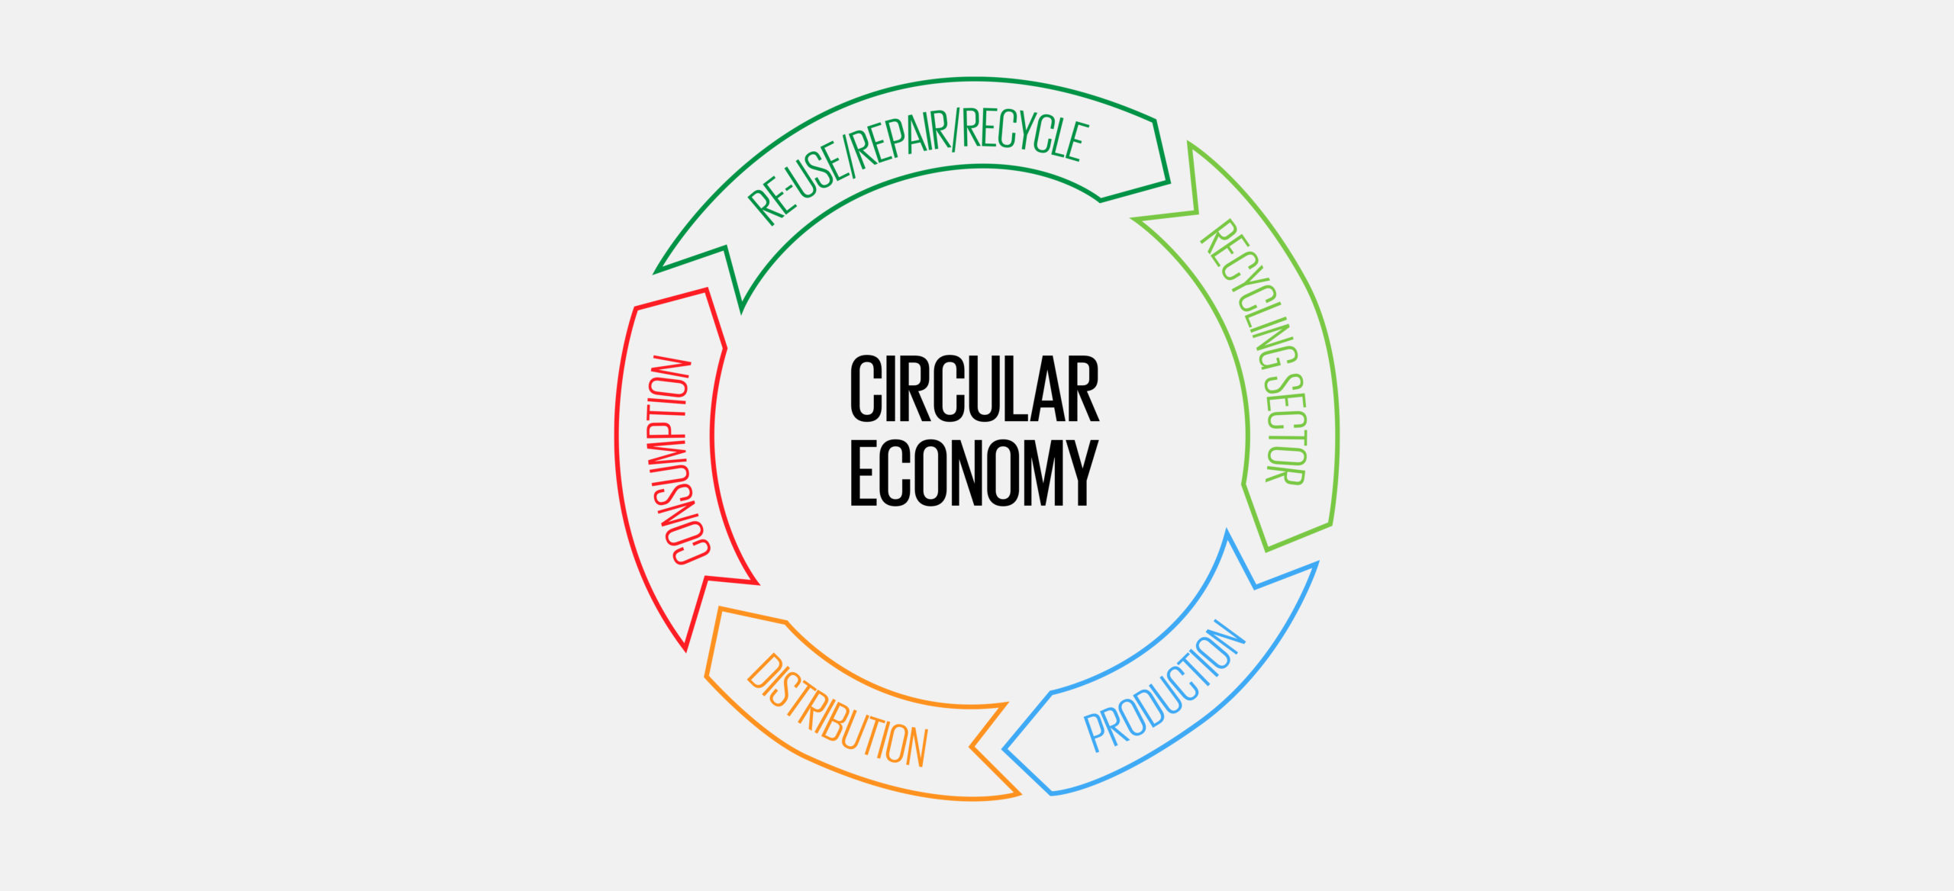
CIRCULAR ECONOMY
Through the concept of circular economy which aims at converting waste into new raw material , we can repurpose the grey water for diverse purposes like cleaning , washing and gardening.

Slide 6
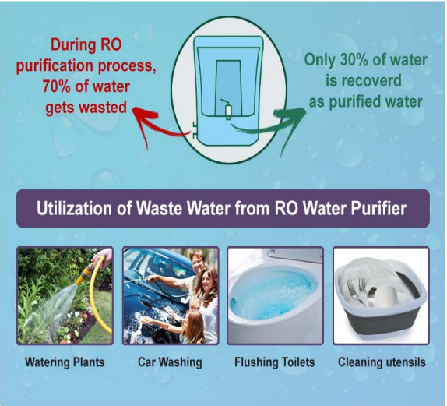
NEER-A way Forward
We have ideated to develop NEER to minimize the wastage of grey water generated from RO purifiers.
10T controlled system equipped with sensors and pipelines.
It can collect ,store and direct water for various purpose.

Slide 7
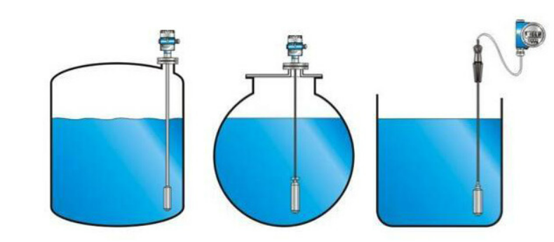
HOW WILL IT WORK?
The tank will be filled with the ejected waste water upto the red mark.
As per demands, the outlets valves of pipes(one at a time) will open and release water .
The automated valves will control the opening and closing of pipes depending on the needs.

Slide 8
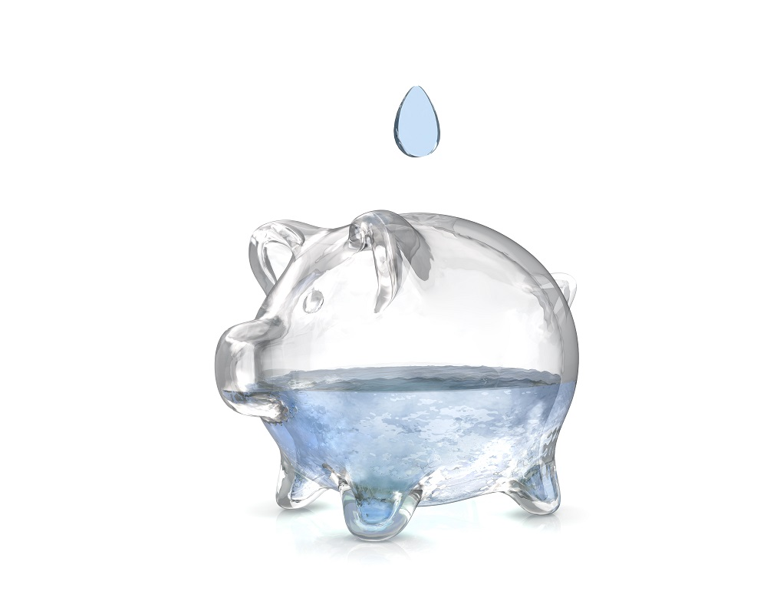
DEALING WITH PRICE CONFLICT
At the present sensors prices , the bucket would cost less than Rs 1000.
Every home RO system could be integrated with its compact version.

Slide 9
Leading to sustainable future
Uses of this bucket will reduce wastage of water and time .
Minimize human efforts and errors.
Reduce direct dependence on fresh water.
Cost effective

Slide 10
It has tremendous potential to contribute to building a sustainable future

